Slide 1
Chapter 8 - Relations

Slide 2
OUR GOAL
Binary relations
Definitions
Properties
Representing relations
Combination of relations
Equivalence relations
N-ary relations
databases and relations

Slide 3



Introduction to binary relations
trainer | trainee
Tuan | Anh
Adam | Titus
Lucy | Long
teacher | student
VinhDP | BaoVL
NamTH | HoaNV
KhanhKT | DanhTC
TruongLV | VietTQ
mother | kid
Hoa | Anh
Hanh | Minh
Giang | Tep
Adam loves Eva
Minh loves Nhan
Hieu loves Hai
Bao loves Minh

Slide 4







Binary relation
Alice
Bob
Diana
Smith
Helen
Bill
Lucy

Slide 5
What are binary relations?
Example 1. Given A = {1, 2, 3, 4} and B = {1, 2, 3}
Study the relation from A to B:
a + b = 5
R = {(a, b) | }
“a is said to be related to b by R”
a R b ⇔ (a, b)∈R
a in A | b in B
2 | 3
3 | 2
4 | 1
R
(2, 3)∈R
(3, 2)∈R
(4, 1)∈R
1 4
(1, 4)∉R
R = {(2, 3), (3, 2), (4, 1)}

Slide 6
Example 2. Given A = {1, 2, 3, 4} and B = {1, 2, 3}
Study the relation from A to B defined by
a divides b
D = {(a, b) | }
a D b ⇔ (a, b)∈D
a in {1, 2, 3, 4} | b in {1, 2, 3}
1 | 1
1 | 2
1 | 3
2 | 2
3 | 3
2 | 4
D
(1, 1)∈D
(1, 2)∈D
(1, 3)∈D
(2, 2)∈D
(3, 3)∈D
D = {(1, 1), (1, 2), (1, 3), (2, 2), (3, 3)}

Slide 7
Binary relations (= relations)
R and D are relations from A = {1, 2, 3, 4} to B = {1, 2, 3}
Note that R and D are subsets of A x B
Definitions.
A binary relation from a set A to a set B is a subset of A x B.
Relations on A are relations from A to A.
R = {(2, 3), (3, 2), (4, 1)}
D = {(1, 1), (1, 2), (1, 3), (2, 2), (3, 3)}

Slide 8
Representing binary relations
Using zero–one matrices (in computer programs)
Using directed graphs (useful for understanding the properties of these relations.)

Slide 9
Matrices
(row i, column j)–entry = (i, j)–entry

Slide 10
Using zero-one Matrices
Ex1. Suppose that A ={1, 2, 3} and B = {1, 2}.
Let R = { (a, b) | a > b} be a relation from A to B
➔ R = { (2, 1), (3, 1), (3, 2)}
➔ The zero-one matrix for R is
R | 1 | 2
1
2 | (2,1)
3 | (3,1) | (3,2)
0
0
1
0
1
1

Slide 11
Using zero-one Matrices
Ex2. Let A = {a, b, c} and B = {1, 2, 3, 4}.
Which ordered pairs are in the relation R from A to B represented by the matrix
Answer: R = { (a, 3), (a, 4), (b, 1), (c, 2), (c, 4) }
1 2 3 4
a
b
c

Slide 12
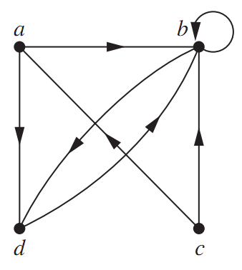
Using directed graphs (digraphs)
Let
R = { (a, b), (a, d), (b, b), (b, d), (c, b), (c, a), (d, b) }
be a relation on A = {a, b, c, d}
loop: arc from b back to itself
(a, d)
(d, a)

Slide 13
Properties of relations on a set A
Recall that a relation on a set A is a subset of A x A.
Reflexive ir-reflexive
Symmetric asymmetric antisymmetric
Transitive

Slide 14

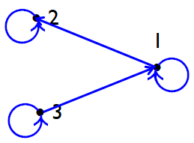
Reflexive relations
A relation R on A is said to be reflexive iff
∀a∈A, a R a
Ex. On {1, 2, 3},
R = {(1, 1), (1, 2), (2, 2), (3, 1), (3, 3)} is reflexive
R | 1 | 2 | 3
1 | 1 | 1 | 0
2 | 0 | 1 | 0
3 | 1 | 0 | 1
Digraph for R
has a loop at
each vertex

Slide 15


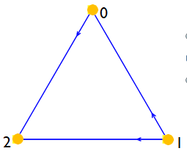
Irreflexive relations
R is called irreflexive iff
Ex. On {0, 1, 2},
R = { (0, 2), (1, 0), (1, 2) } is an irreflexive relation
R | 0 | 1 | 2
0 | 0 | 0 | 1
1 | 1 | 0 | 1
2 | 0 | 0 | 0
Digraph for R
has no loops

Slide 16
Example
Let A be the set of all real numbers
R = {(x, y) | x + y > 0}
State TRUE/FALSE
(3, 2)∈R
(-2, 5/3)∈R
R is reflexive
R is irreflexive
T 3 + 2 > 0
F -2 + 5/3 < 0
F -2 + (-2) < 0
F 3 + 3 > 0
Try to find a counterexample

Slide 17



Symmetric relations
A relation R on A is said to be symmetric iff
∀a∀b ( aRb → bRa )
(Counter example: )
Ex. On A = {a, b, c, d},
R = {(a, b), (a, c), (a, d), (b, a), (b, b), (c, a), (d, a), (d, d)}
is symmetric (no counterexamples)

Slide 18
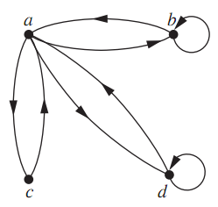
Symmetric relations
R = {(a, b), (a, c), (a, d), (b, a), (b, b), (c, a), (d, a), (d, d)}
R | a | b | c | d
a | 0 | 1 | 1 | 1
b | 1 | 1 | 0 | 0
c | 1 | 0 | 0 | 0
d | 1 | 0 | 0 | 1
Digraph for R
Matrix for R is symmetric

Slide 19
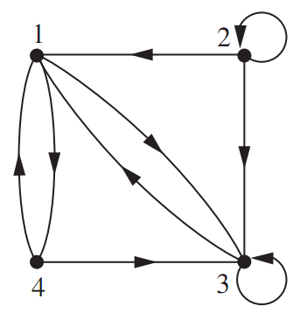
Example
Is R symmetric?
Try to find a counterexample
(2, 1)∈R but (1, 2)∉R
Find the matrix for R
R | 1 | 2 | 3 | 4
1 | 0 | 0 | 1 | 1
2 | 1 | 1 | 1 | 0
3 | 1 | 0 | 1 | 0
4 | 1 | 0 | 1 | 0
Digraph for R

Slide 20

Asymmetric relations
A relation R on A is said to be asymmetric iff
Counter example: aRb but bRa
Ex. On {1, 2, 3},
R = { (1, 3), (2, 1), (3, 1) } is not asymmetric
(counterexample: 1R3 but 3R1
Is S ={ (1,2), (2, 3), (3, 1), (3, 3) } asymmetric?
Try to find a counterexample:
3R3 but 3R3

Slide 21
Example
Is R asymmetric?
Not
Counterexample
(1,4) and (4, 1) ∈R
R | 1 | 2 | 3 | 4
1 | 0 | 0 | 1 | 1
2 | 1 | 1 | 1 | 0
3 | 1 | 0 | 1 | 0
4 | 1 | 0 | 1 | 0
Digraph for R
Matrix for R

Slide 22

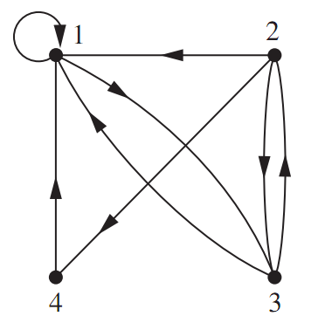
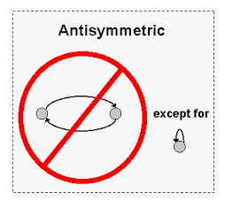
Anti-symmetric relations
A relation R on A is called anti-symmetric iff
∀a∀b ( aRb, bRa → a = b )
Equivalently,
Counterexample aRb, a ≠ b but bRa
Not OK
(1, 3)∈R
(3, 1)∈R
Digraph for R

Slide 23
Example
Given the matrix for a relation R on {1, 2, 3, 4}
Is R anti-symmetric?
Try to find a counterexample
R | 1 | 2 | 3 | 4
1 | 0 | 0 | 1 | 1
2 | 1 | 1 | 1 | 0
3 | 1 | 0 | 1 | 0
4 | 1 | 0 | 1 | 0
1R3
3R1
Digraph for R
Matrix for R

Slide 24

Asymmetric vs anti-symmetric
Asymmetric Anti-symmetric
Not allowed
Allowed

Slide 25
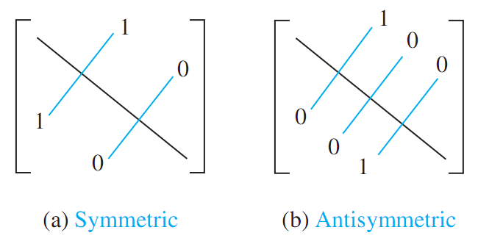
Symmetric vs anti-symmetric

Slide 26


Transitive relations
A relation R on A is called transitive iff
∀a∀b∀c ( aRb, bRc → aRc )
Counter example
Ex. Given A = {1, 2, 3}
R = {(1, 2), (2, 3), (1, 3), (3, 1)} is not transitive
Counter example
S = { (1, 2), (1, 3) } is transitive
No counter examples
• b
bRc
aRb
a •
• c
aRc

Slide 27
Exercise
Determine whether the relation R on Z is reflexive, ir-reflexive, symmetric, asymmetric, anti-symmetric, transitive.
x R y ⇔ x = 2y
(Hint: Try to find counterexamples)
Property | Yes | Counter example
Reflexive | x | 3 ≠ 2.3
Irreflexive | x | 0 = 2.0
Symmetric | x | 6 = 2.3 but 3 ≠ 2.6
Asymmetric | x | 0 = 2.0
Antisymmetric | ✓ | If x = 2y, y = 2x ➔ x = 4x ➔ x = 0 = y
Transitive | x | 12 = 2.6, 6 = 2.3 but 12≠2.3

Slide 28
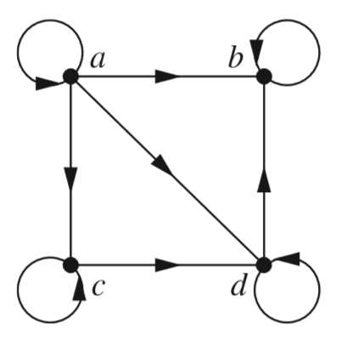
Exercise
Consider a relation R on {a, b, c, d}
given by the graph below.
Property | Yes | Counter example
Reflexive | Y | There is loop at each vertex
Irreflexive | N | (a, a)∈R
Symmetric | N | (a, d)∈R but (d, a)∉R
Asymmetric | N | (b, b)∈R but (b, b)∈R // there is a loop at b
Antisymmetric | Y | No counter examples
Transitive | N | (c, d) ∈R, (d, b) ∈R but (c, b)∉R

Slide 29
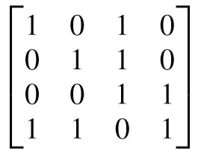
Exercise
Given the matrix representing a relation on { 1, 2, 3, 4 }.
Property | Yes/No | Counter example
Reflexive | Y | No counterexamples, a[i, i] = 1, for i = 1, 2, 3, 4
Irreflexive | N | a[2,2] = 1
Symmetric | N | a[1, 3] ≠ a[3, 1]
Asymmetric | N | a[3, 3] = 1
Antisymmetric | Y | No counterexamples, a[i,j] = a[j,i] ➔ i = j

Slide 30
Exercises
Determine whether each of these relations on Z is reflexive, ir-reflexive, symmetric, asymmetric, anti-symmetric, transitive.
(Hint: Try to find counterexamples)
(a) x R y ⇔ x + y = 2018
(b) x R y ⇔ x = y³
(c) a R b ⇔ a ≡ b (mod 5)
Properties | (a) | (b) | (c)
Reflexive |  |  | Y
Irreflexive
Symmetric | Y |  | Y
Asymmetric
Antisymmetric |  | Y
Transitive |  |  | Y

Slide 31
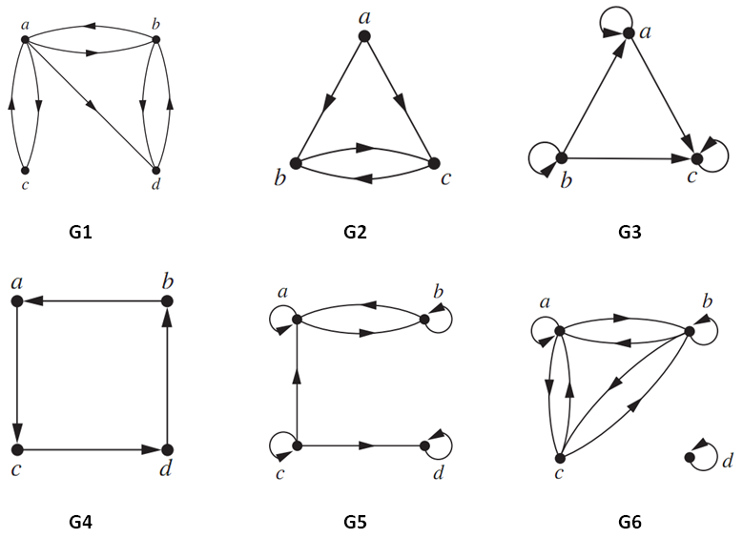
Exercises
Which relations are reflexive, ir-reflexive, symmetric, asymmetric, anti-symmetric, or/and transitive?
Properties | G1 | G2 | G3 | G4 | G5 | G6
Reflexive
Irreflexive
Symmetric
Asymmetric
Antisymmetric
Transitive

Slide 32
Exercises
Which relations are reflexive, ir-reflexive, symmetric, asymmetric, anti-symmetric, or/and transitive?
Properties | G1 | G2 | G3 | G4 | G5 | G6
Reflexive |  |  | Y |  | Y
Irreflexive | Y | Y |  | Y
Symmetric |  |  |  |  |  | Y
Asymmetric |  |  |  | Y
Antisymmetric |  |  | Y | Y
Transitive |  |  | Y

Slide 33
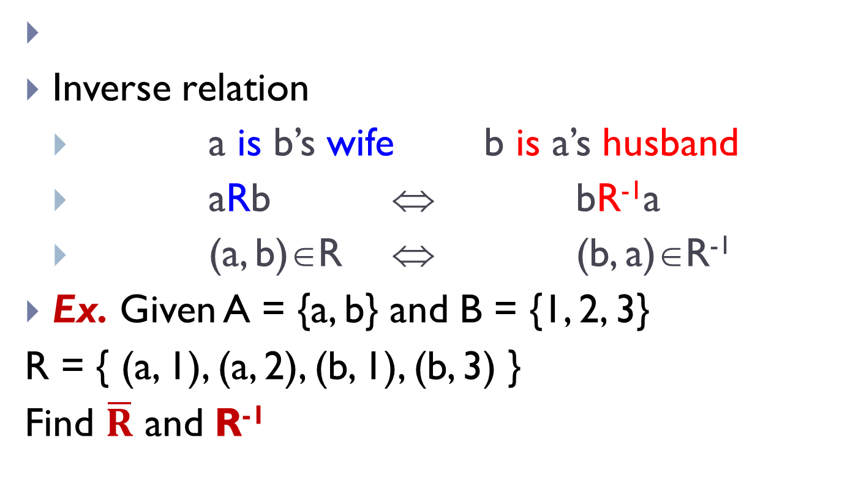
Combinations of relations
Inverse relation
a is b’s wife b is a’s husband
aRb ⇔ bR⁻¹a
(a, b)∈R ⇔ (b, a)∈R⁻¹
Ex. Given A = {a, b} and B = {1, 2, 3}
R = { (a, 1), (a, 2), (b, 1), (b, 3) }
Find $\overline{R}$ and R⁻¹

Slide 34
Composite relations
a is b’s mother
b is c’s husband
So, a is _____ c
Ex. Given A = {a, b, c}, B = {d, e, f, g}, C = {m, n, o}
R = {(a, e), (a, f), (b, d), (c, d), (c, g)}
S = {(d, m), (e, m), (f, o)}
Construct S□R
aRe, eSm ➔ aS□Rm, and so on.
a R b
b S c
mother of ‘s husband
S□R = { (a, m), (a, o), (b, m), (c, m) }

Slide 35

Equivalence relations
1 7
4
10
2
5
8
3
6
9
We are the same
We are the same
Special relation:
“a and b are the same gender”
“the same” with respect to some special
relation

Slide 36
Equivalence relations
A relation R on a set A is called an equivalence relation iff it satisfies 3 properties:
reflexive
symmetric
transitive
Ex. “a ≡ b (mod m)” on Z
a ≡ a (mod m)
a ≡ b (mod m) → b ≡ a (mod m)
a ≡ b (mod m), b ≡ c (mod m) → a ≡ c (mod m)
a ~ a
a ~ b ➔ b ~ a
a ~ b, b ~ c ➔ a ~ c
“a R b” can be replaced by a ~ b

Slide 37
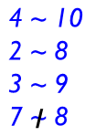
Equivalence classes
Class [1]_{R} = {1, 4, 7, 10}
Class [3]_{R} = {2, 5, 8}
On A = {1, 2, 3, 4, 5, 6, 7, 8, 9, 10}
a R b ⇔ a ≡ b (mod 3)
➔ R is an equivalence relation
With respect to R, we have
1 7
4
10
2
5
8
3
6
9
Class [3]_{R} = {3, 6, 9}

Slide 38
Equivalence classes and partitions
We call the collection
{1, 4, 7, 10}, {2, 5, 8}, {3, 6, 9}
is a partition of
A = {1, 2, 3, 4, 5, 6, 7, 8, 9, 10}
Eq. relation on A  a partition of A
A partition of A  an eq. relation on A
1 7
4
10
2
5
8
3
6
9

Slide 39
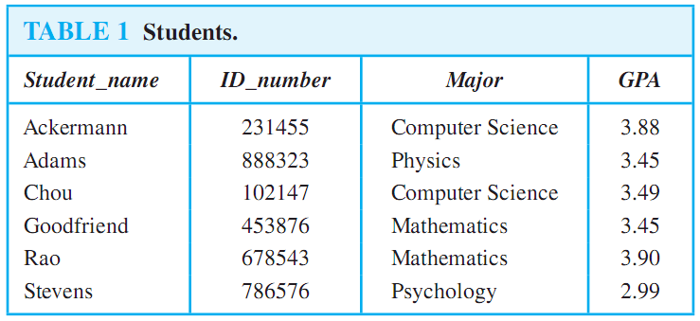
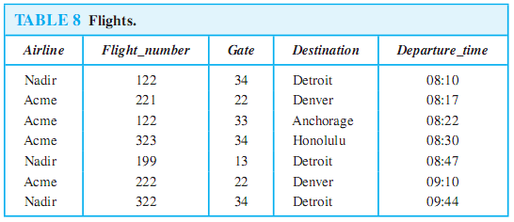
N-ary relations and databases
Binary relation: R ⊆ A x B
3-ary relation: R ⊆ A x B x C
n-ary relation: R ⊆ A₁ x A₂ x … x A_{n}
Ex.
n: degree
composite key
primary key
4-ary relation
5-ary relation
5-tuple = record

Slide 40
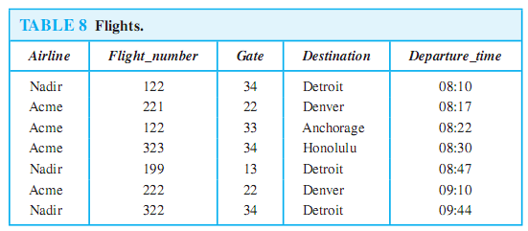
Operations on n-ary Relations
Selection operator S_{C}
How many records are there in the table obtained when S_{Destination=‘Detroit’} is applied to the relation in the table below?
Answer = 3

Slide 41
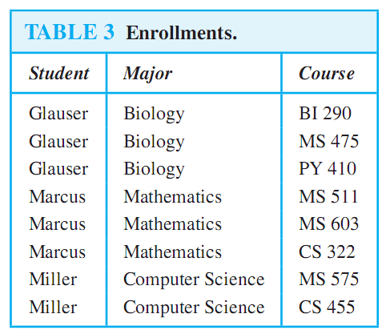
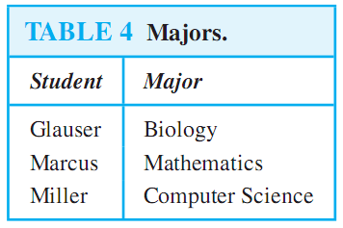
Operations on n-ary Relations
Projection
P_{1,2}

Slide 42
Operations on n-ary Relations
Join J_{p}
How many records are there in the table obtained after applying the join operator J₂?
Lecturers
Courses
Lecturer | Room | Slot
AnhLTK | 209 | 2
NamTH | 211 | 3
VanTTN | 313 | 2
Room | Slot | Course
209 | 1 | MAD101
211 | 3 | PRJ291
313 | 2 | Alice
Join J₂
Answer: 2

Slide 43
Summary
Binary relations
from a set A to a set B
on a set A
Properties of a relation
reflexive, symmetric, anti-symmetric, transitive
Representing relations
zero-one matrices
digraphs
Combination of relations: ∩, ∪, ⊕, complement, compositions
Equivalence relations
Eq. classes and partitions
n-ary relations
databases and relations

Slide 44
THANKS

